Slide 1
Convection

Slide 2
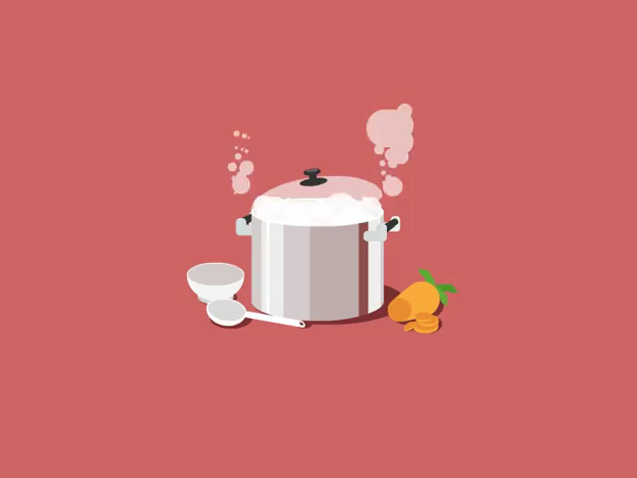
By the end of this lesson you will be able to:
Describe how a convection current is formed.
Explain how a convection current transfers heats throughout a space.

Slide 3

Did you know heat can be transferred between objects that are not touching each other?
There are two main ways in which this can occur: convection and radiation.
This Smart Lesson will focus on convection.

Slide 4
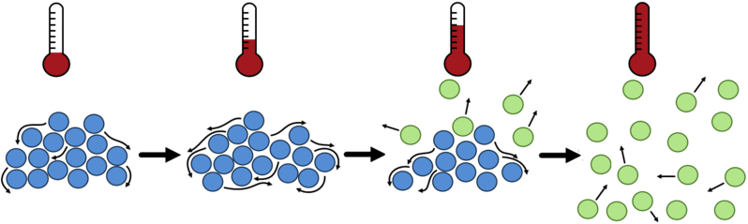
Convection occurs in fluids. Fluids is a term which includes both gases and liquids.
First, one part of the fluid is heated. This causes the particles to move apart, making this part of the fluid less dense than the surrounding fluid.

Slide 5
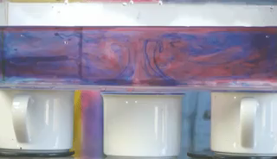
The hot, less dense part of the fluid rises.
Cool fluid moves into the space freed up by the less dense part of the fluid. This then gets heated and rises.

Slide 6
The heated fluid cools down as it moves away from the heat source.
This causes it to become more dense and sink again.
The fluid can then be heated again, continuing the cycle.
This movement of fluid is called a convection current.

Slide 7
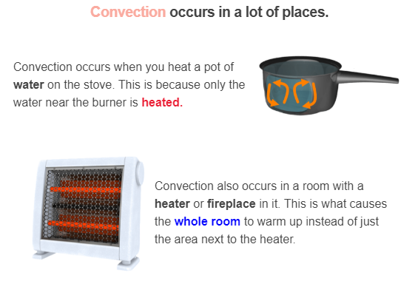

Slide 8
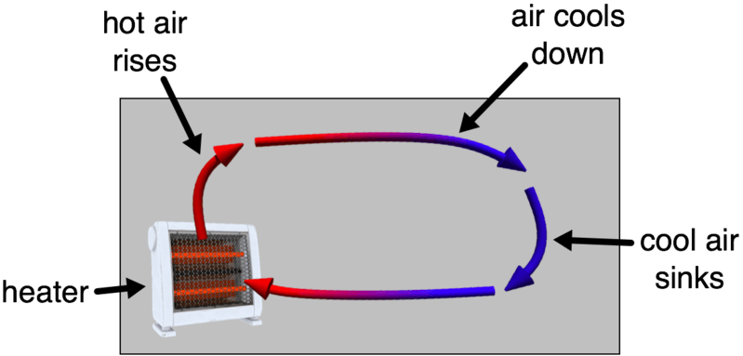
This diagram shows how heaters use convection to warm the whole room.

Slide 9
